Slide 1
Richard David Kann Melanoma Foundation
An Opportunity to Save Lives

Slide 2
Our Mission
To save lives through education about the prevention and early detection of skin cancer, especially melanoma.

Slide 3
Our Vision
To empower children and families throughout the County and give them the skills necessary to make critical choices for healthy lives.

Slide 4
Facts from the AAD
One person dies from melanoma every 50 minutes!
One in fifty people will be at risk to develop melanoma
Florida is the state with the second highest incidence of melanoma
If caught early, there is a 99% cure rate
If late detected, there is a less than 15% cure rate

Slide 5
More Facts
Melanoma is the most common form of cancer for young adults 25-29 years old
Second most common form of cancer in 15–29 years olds
More than one severe sunburn during the first 18 years of life can double your risk of skin cancer
Almost ALL skin cancer is caused by over exposure to the sun or artificial light sources. (Tanning Beds!)
Melanoma is the fastest growing cancer in the United States
While all other cancers are decreasing in incidence, melanoma is increasing BUT it is the only cancer that can be prevented with EDUCATION!

Slide 6
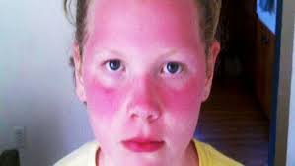
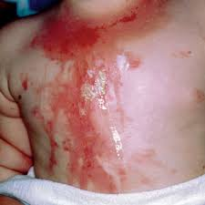
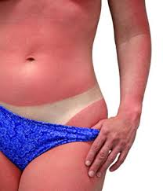
A Sunburn is a First Degree Burn!

Slide 7

Who Can Get Melanoma?
Everyone!
While Caucasians are higher at risk to get melanoma, Asian and African American patients have a greater tendency to present with advanced disease at the time of diagnosis because it is harder to “spot the spot”.
Some areas to take special notice of are: Palms, soles of the feet, eyes (ocular melanoma), mucous membranes, and nail bed regions.
Bob Marley died of a late detected melanoma in 1981, he was 36 years young.

Slide 8



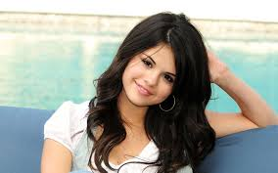
“That’s Not Our Disease.”
As skin cancer rates rise in Hispanics, many remain unaware they are at risk!
“Only pale-skinned, blue-eyed Caucasians get skin cancer.”
That’s a misconception many Hispanics in the US share.
• More than 43% reported that they never or rarely used sunscreen
• Only 24% said they wear sun-protective clothing
• Nearly 40% said they sunbathe
• 1 in 3 said they sunburned in the past year!

Slide 9
How Risk Factors Relate to YOU
If you have a family history of melanoma
If you have a personal history of melanoma
If you had one or more blistering sunburns before the age of 18
Fair skin and eyes
More than fifty moles on your body
Immune suppression disease or organ transplant
Frequently spend time in the sun between the hours of 10:00 am to 4:00 pm WITHOUT skin protection of at least SPF 30-50+
Use or have used tanning beds!

Slide 10
The ABC’s of Melanoma
Any change in a mole requires the attention of a Dermatologist. While, one should learn how to perform a self exam, every six to eight weeks, annual visits to a Dermatologist can be life-saving!
Asymmetry: When half of the mole or lesion does not match the other
Borders: Melanomas often have blurred, notched, ragged or uneven edges
Colors: Healthy moles are usually a single shade or color
Diameter: Moles that grow larger than a pencil eraser are a cause for concern
Evolving in ANY WAY!

Slide 11
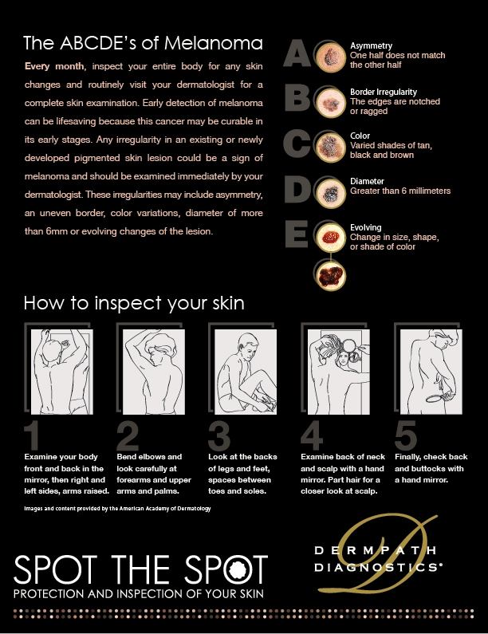

Slide 12

Tanning Beds
There are more tanning salons in Florida than the most popular fast food restaurant!
2.3 million teens visit a tanning salon a least once a year
One indoor tanning session increases the user’s chances of developing melanoma by 20%
DO NOT GO IN A TANNING BED OR USE ARTIFICIAL LIGHT SOURCES
LOVE THE SKIN YOU ARE IN! If you must alter the color of your skin, try safe alternatives, such as an over the counter self-tanner, or visit a professional spa/salon
for an organic spray tan.

Slide 13
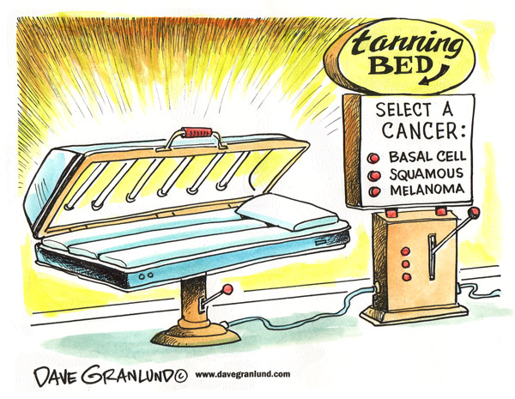
10 Minutes in a Tanning Bed =‘s
4 Hours on the Beach!

Slide 14
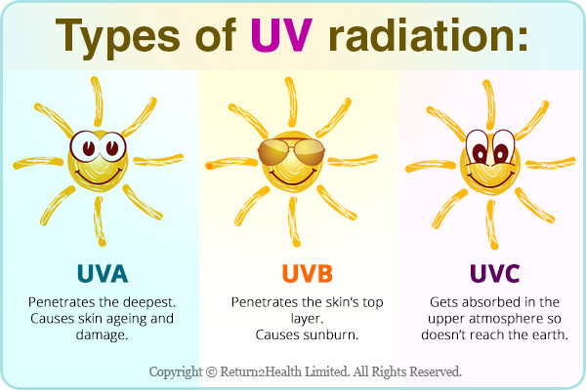
What is UV?

Slide 15
The Harmful Rays of the Sun
UVA rays cause skin aging and wrinkling, and contribute to melanoma
UVB rays are also dangerous, causing sunburns, cataracts, and effects the immune system
UVC rays are the most dangerous, but fortunately, these rays are blocked by the ozone layer and don’t reach the earth. This is why it is important to wear a broad spectrum sunscreen/block, to block all the damaging rays of the sun!
You can get a sunburn even on a cloudy day! Up to 80% of the sun’s rays can penetrate light clouds, mist and fog
You can also receive a burn when you are swimming and skiing; water and snow are reflective, they actually intensify the harmful rays of the sun

Slide 16
Sunscreen
Choose a broad spectrum sunscreen that takes care of UVA & UVB Rays
Apply 20 minutes before going outside so it penetrates your skin
Cover all exposed areas (about 2 ounces, or a shot glass full)
Don’t use sprays, they fly all over the place
Use an SPF factor of 30-50+
Sunscreen is not waterproof, it is water resistant. (For 40-80 minutes)
You must reapply every two hours, especially if you sweat or swim
You can check out your sunscreen’s quality by downloading the app from the EWG, called Skin Deep. See how yours measures up.

Slide 17
The “S” Word - SunSmarts™
Slip on sun protection clothing – Keep covered up while in the sun when possible.
Slap on a hat – A hat with a wide brim will not only shade your face and neck from the sun’s harmful rays, but will keep the rays from penetrating your hair and causing harm to your scalp.
Slop on Sunscreen – Apply a broad-spectrum, water-resistant sunscreen and protective lip balm. Choose a sunscreen with an SPF of 30-50+. Be sure to apply it 20 minutes before you are going to be in the sun and reapply it at least every two hours, especially if you are swimming or sweating.
Style with a pair of shades – Your eyes are just as susceptible to the damaging effects of UV (ultraviolet) rays as the rest of your body. Make sure your sunglasses block both UVA and UVB rays.
Seek Shade – Avoiding sun exposure, especially during the hours between 10am – 4pm, when the sun’s rays are the strongest.
Stay out of tanning beds – There is a 75% increase of developing melanoma, and non-melanoma cancer, for those who have been exposed to UV radiation from indoor tanning.

Slide 18
Be Ready for Common Questions
Don’t I need some sun exposure to get my Vitamin D?
  10-15 minutes per day of sun exposure is all that’s needed to make your required amounts; Vitamin D supplements and and a healthy diet are just as good!
Aren’t tanning beds safer since I spend only a few minutes and don’t get burned?
  Although indoor tanning devices operate on a timer, the beds are designed to give you high levels of UV radiation in a short time. You can get a burn from tanning indoors, and even a tan indicates damage to your skin.
  Source: cdc.gov

Slide 19

How to Get the Word Out!
START A “SAM CLUB” IN YOUR SCHOOL
Students Against Melanoma
Earn Community Service Hours
Help Save Lives!

Slide 20
What can SAM Clubs do?
Empower their peers and the community to MAKE CRITICAL SUN SAFE CHOICES FOR A HEALTHY LIFE!
Encourage teachers, nurses and all healthcare professionals to utilize the free SunSmart™ America curriculum and resources from our Foundation during the year, especially at high risk times like Prom and Breaks
Have a Melanoma Booth at any “race” or other highly attended event
Talk to the Parent Associations at your school
Have SAM go to the elementary schools and teach young children to practice sun safety
Have an event to raise awareness – bring in the Dermaview machine
Be a roll model and practice sun safety as a family and community!
Show “16 Year Old Me” and post it on your social media accounts
Go on school TV or morning announcements with sun safety messaging

Slide 21

“Dear 16 Year Old Me”
Today’s Symposium is dedicated to Lauren, with get well wishes.
Please click to view movie
Please click on the screen to start video

Slide 22
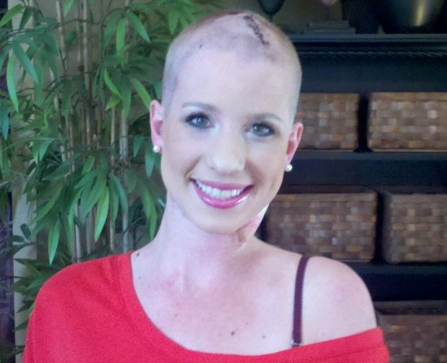
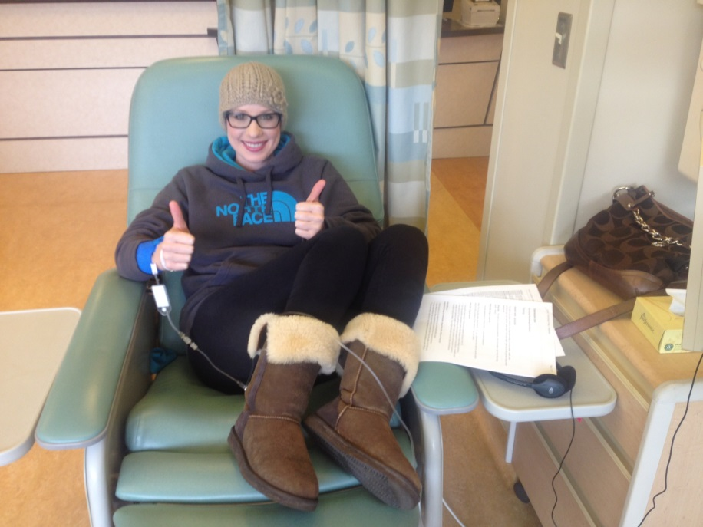
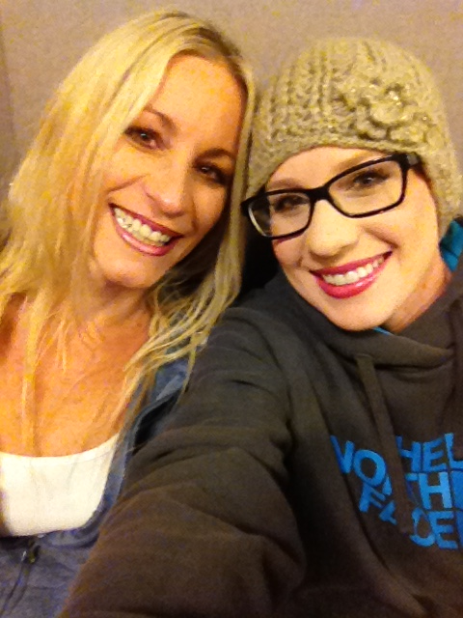
As teens, Lauren Race and her friend used tanning beds all week long. They had competitions to see who could get the tannest.
Lauren received a stage 4 diagnosis of melanoma at age 24.

Slide 23
For More Information
Please visit our website: www.melanomafoundation.com for:
Skin cancer links
Free online education and resources
Events
Volunteer opportunities
Information in the News
Kid’s activities
How to start a school-based SAM (Students Against Melanoma) Club in Middle and High School. (community service hours!)
Don’t forget to LIKE US ON FACEBOOK!
Call Executive Director, Lisa Richman at: 561-655-9655

