Slide 1
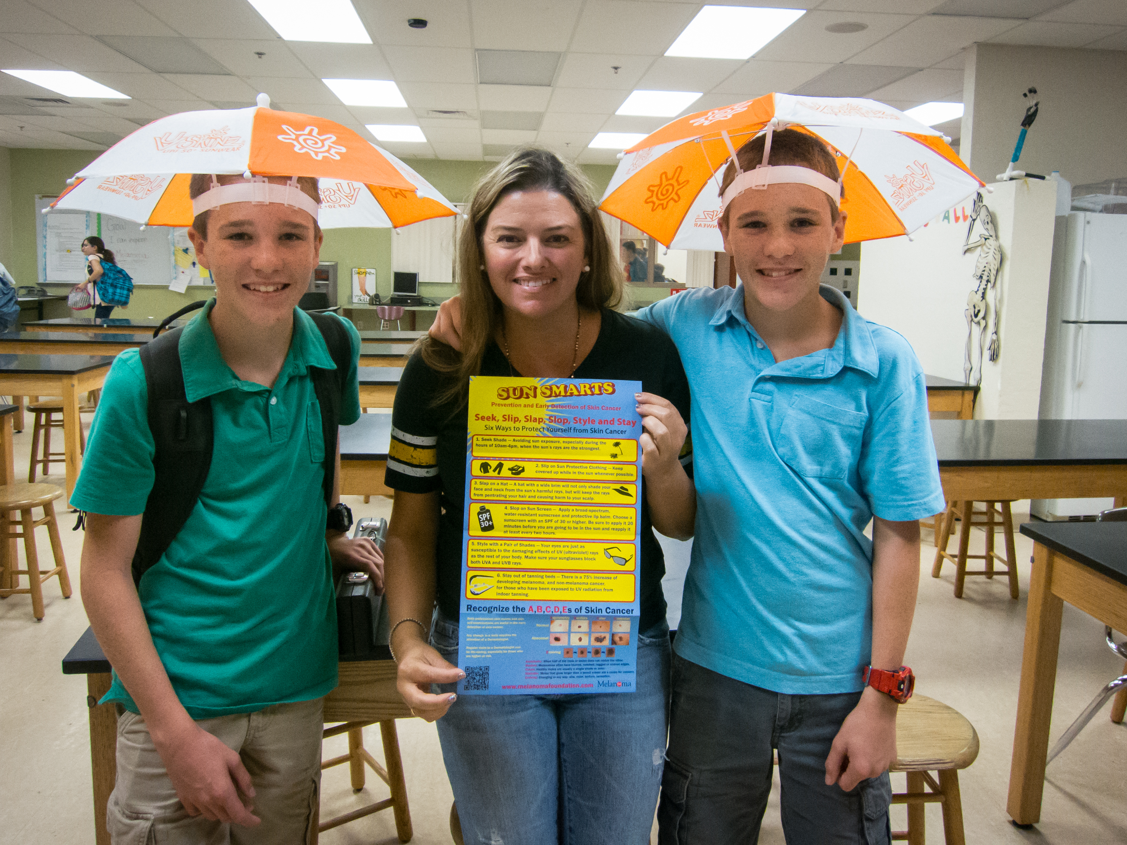
Richard David Kann Melanoma Foundation
SunSmart America™ K-12
Curriculum and Resources
Learn and Earn
Professional Development Credits

Slide 2
It’s “E”asy
Sun Safety Education is Something Everyone Needs to Know
Empower Yourself & Your Students
Easy Online Implementation

Slide 3
It’s a Numbers Game
4 Lessons
4 Independent Objectives
30 minutes to complete each lesson

Slide 4
Different Disciplines
Science
Health
Language Arts
Math

Slide 5
Lessons Include:
Persuasive Writing Activities
Social Studies
Mapping
Art Projects
Math Calculations
Graphing

Slide 6
Facts from the AAD
One person dies from melanoma every 50 minutes!
Florida is the state with the second highest incidence of melanoma nationwide
More than one severe sunburn during the first 18 years of life can double your risk of skin cancer
It’s not an old person’s disease, it is the second most common from of cancer in 15-29 year olds
Kids as young as 4 get melanoma

Slide 7
Why is it Critical to Teach Sun Safety to Kids
During the first 18 years of a child’s life, they are exposed to more sun than they most likely will experience the rest of their lives.
Their skin is more sensitive to UV Rays.
This is the time when they are most malleable and the knowledge
we provide will sustain them during adulthood.
Like many things that should be taught early on at home, and are not, teachers have the opportunity to affect change and make a difference!

Slide 8
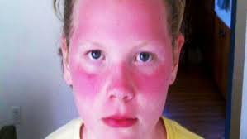
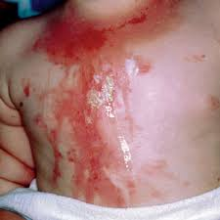
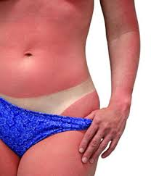
A Sunburn is a First Degree Burn!

Slide 9
What To Expect From Each Lesson
Name of Lesson
Benchmark Correlations
Pre-Assessment (“Who can tell me…”)
Discussion (Explanation)
Vocabulary
1-3 Different School Activities
Home Activities
Supporting information students may share with parents
Resources

Slide 10
Sample Classroom Activity
  Activity 1 – Sun Scientist
  Type of Activity: Small Group or Class
  Type of Skill: Compare, Predict
  Learning Skill: Math/Logical
  Materials Needed: 2 pieces of newspaper, 2 pieces of fruit, etc.
  Suggestions: Divide the class into 4 groups…

Slide 11
14 Points Given Upon Completion
Go to the Richard David Kann Melanoma Foundation website homepage
Click on SunSmart America Training
  Teacher/School Nurse Training
Sign Up
  When you receive your registration email, follow activation link
Begin Teacher Training (Auto save mode, complete at your own pace)
When complete, return to homepage and simply click on the Curriculum Guides and start saving lives!
Submit work as per the easy deadline schedule
Receive your credits and have a sun safe life!

Slide 12
Easy Deadlines
Pre-test (before each lesson) and classroom activity schedule
Lesson 1
  Deadline: December 18, 2015
Lesson 2
  Deadline: January 21, 2016
Lesson 3
  Deadline: March 10, 2016
Lesson 4
  Deadline: April 15, 2016 (for your taxes too!)
  NOTE: Lesson 4, administer both Pre and Post test, this is the final lesson!

Slide 13
Great Timing for your
Lucky Students
  March 1st kicks off the countywide
  Melanoma Monday Art Contest in Schools
  April is “RAYS”ing Awareness: Playground Safety/Sun Safety Month in all Palm Beach County Schools
  May is Melanoma Awareness Month Nationwide
  June, July, and August is the long, hot, sun burning summer, but
  Not for YOU and YOUR Students!

Slide 14
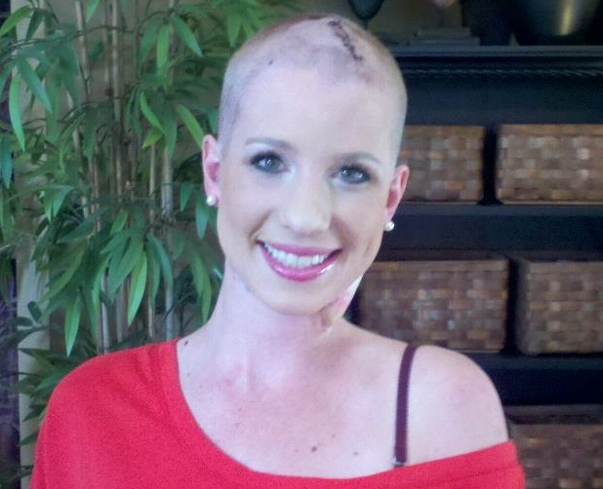
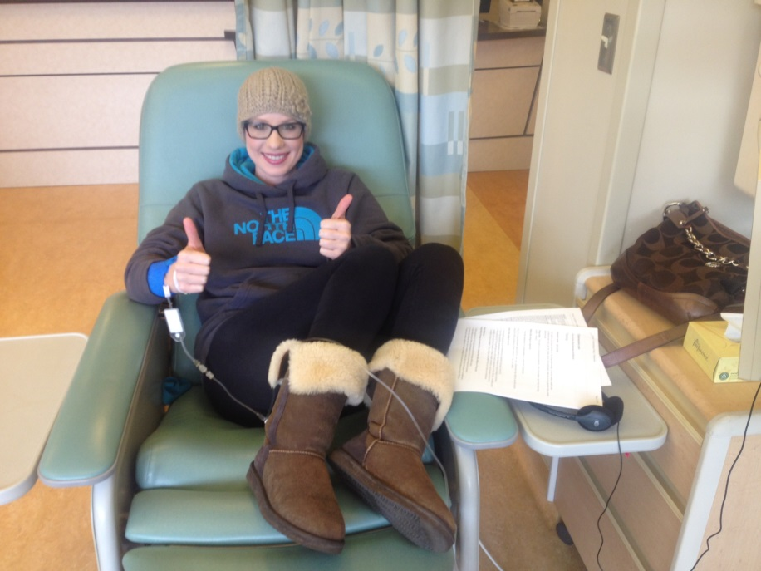
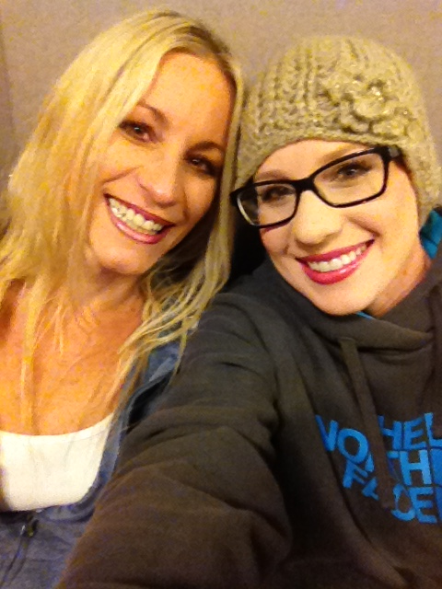
This presentation is dedicated to Lauren Race. She wanted everyone to know that being sun safe can save YOUR life!
Lauren received a stage 4 diagnosis of melanoma at age 24.

Slide 15
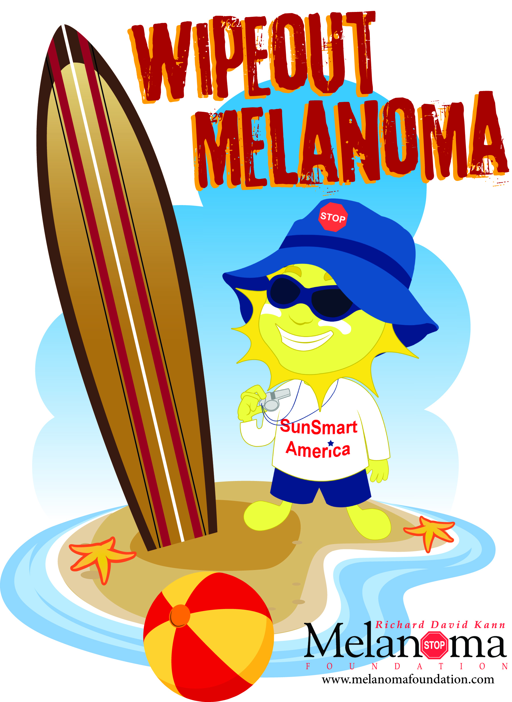
Be Sun Safe!

Slide 16
For More Information
If you have questions or technical difficulties, please contact me at The Richard David Kann Melanoma Foundation.
Lisa Richman: 561-655-9655
lrichman@melanomafoundation.com

